Slide 1
Stack
Mohammad Shahid Qureshi

Slide 2
Introduction
“A Stack is a special kind of list in which all insertions and deletions take place at one end, called the Top”
Other Names
Pushdown List
Last In First Out (LIFO)
Notes:
But NO constraints on HOW the problem is solved

Slide 3
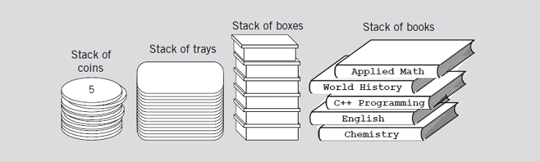
Examples of Stacks
Books on a floor
Dishes on a shelf
FIGURE 7-1 Various examples of stacks

Slide 4
Common Operations on Stacks
TOP(): Return the element at the top of stack S.
POP(): Remove the top element of the stack.
PUSH(S): Insert the element x at the top of the stack.
ISEMPTY(): To check if stack is empty or not
ClearStack();
No other member functions allowed

Slide 5
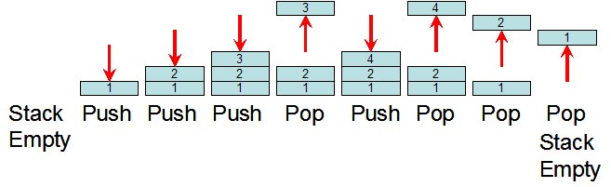
Push and Pop operations of Stack

Slide 6
Static and Dynamic Stacks
There are two kinds of stack data structure -
  a) static, i.e. they have a fixed size, and are implemented as arrays.
  b) dynamic, i.e. they grow in size as needed, and implemented as linked lists

Slide 7
A Linked-List Implementation of Stacks
Stack can expand or shrink with each PUSH or POP operation.
PUSH and POP operate only on the header cell and the first cell on the list.
.
Top
x
y
z

Slide 8
Linked List Implementation of Stack
class Stack
{
struct node
{
int data;
node *next;
};
node *top;
int size;
public:
Stack(void) // Constructor
{ top = NULL; size=0; }
void Push(int newelement);
void Pop(void);
int Top();
bool IsEmpty();
};

Slide 9
void Stack::Push(int newelement)
{
node *newptr;
newptr=new node;
newptr->data=newelement;
newptr->next=top;
top=newptr;
size++;
}
void Stack::Pop(void)
{
if (IsEmpty()) { cout<<“underflow error”; return;}
tempptr=top;
top=top->next;
delete tempptr;
size--;
}

Slide 10
bool Stack::IsEmpty()
{
if (top==NULL) return true;
else
return false;
}
Int Stack::Top()
{
return top->info;
}

Slide 11
Stack Templates
The stack class so far work with integers only. A stack template can be used to work with any data type.

Slide 12
Applications of Stack
Mohammad Shahid Qureshi

Slide 13
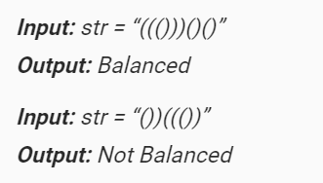
Checking for balanced parentheses (only round pranthesis )
Solution:
  Using a counter can check for balanced pranthesis
  Increment when ‘(’ , decrement when ‘)’

Slide 14
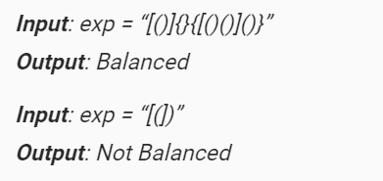
Checking for balanced paranthesis
Solution:
  Counter option will not work over here
  Lets see another solution
Reference: https://www.geeksforgeeks.org/check-for-balanced-parentheses-in-an-expression/

Slide 15
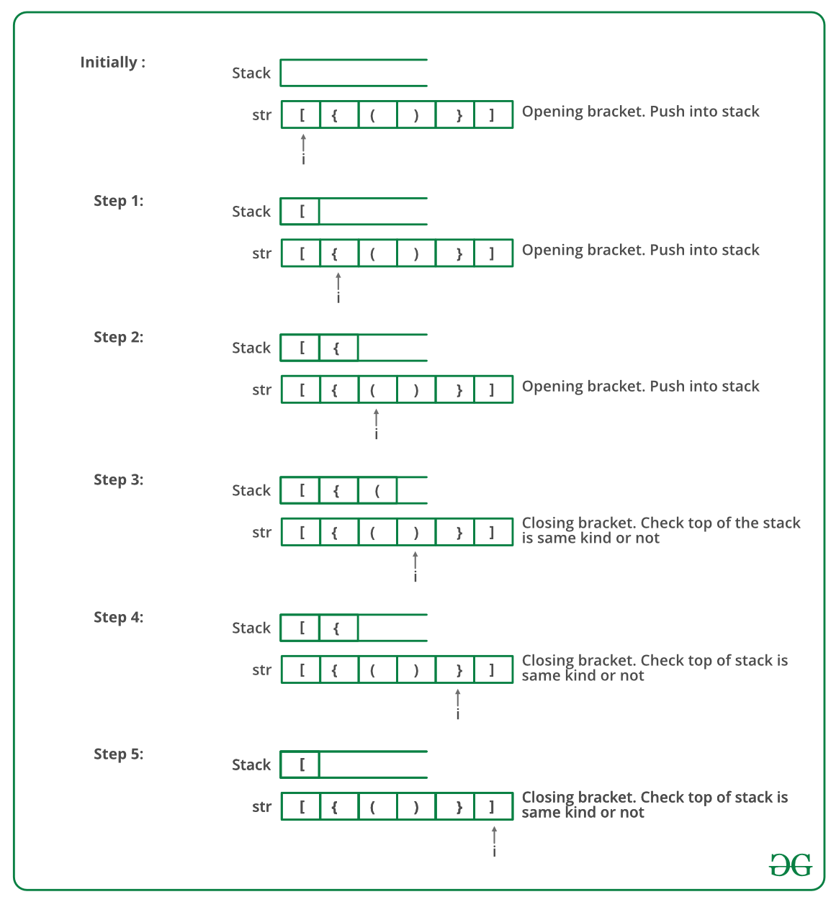

Slide 16
STACK APPLICATIONS
Evaluating arithmetic expression using stacks
  Consider the following expression
    (((6 + 9) / 3) * (6 - 4))
  First do it by hand step by step
  Any idea about implementation ?
  Hint: use two stacks, one for operands and other for operators

Slide 17
Solution
    (((6 + 9) / 3) * (6 - 4))
KEY:
Whenever we reach a right parentheses, we combine the top two numbers using the topmost operation, and result is pushed back onto the numbers stack
Numbers goes here in this stack
Operators goes here in this stack

Slide 18
Postfix Expression
When operator is between two operands, its known as infix expression
When operator is after the two operands, its known as postfix expression
Advantage
  With postfix notation, no brackets are needed, and no precedence rules are needed
Examples
  Infix: A+B*C
  Postfix: ABC*+

Slide 19
Infix: ( ((A+B)*C)-(D-E) ) / (F+G)
Conversion to Postfix Expression
  ( ((AB+)*C)-(DE-) ) / (FG+)
  ( (AB+C*)-(DE-) ) / (FG+)
  (AB+C*DE--) / (FG+)
  AB+C*DE- -FG+/
Exercise: Convert the following to Postfix
  ( A + B ) * ( C – D)
  A / B * C – D + E / (G + H)

Slide 20
Algorithm to Evaluate a Postfix Expression
Example:
Postfix Expression: 6 2 3 + - 3 8 2 / + * 2 ^ 3 +
symb | opnd1 | opnd2 | value | opndstk
6 |  |  |  | 6
2 |  |  |  | 6,2
3 |  |  |  | 6,2,3
+ | 2 | 3 | 5 | 6,5
- | 6 | 5 | 1 | 1
3 | 6 | 5 | 1 | 1,3
8 | 6 | 5 | 1 | 1,3,8
2 | 6 | 5 | 1 | 1,3,8,2
/ | 8 | 2 | 4 | 1,3,4
+ | 3 | 4 | 7 | 1,7
* | 1 | 7 | 7 | 7
2 | 1 | 7 | 7 | 7,2
^ | 7 | 2 | 49 | 49
3 | 7 | 2 | 49 | 49,3
+ | 49 | 3 | 52 | 52

Slide 21
Infix to Postfix Conversion
Assumption: Infix expression contains no parenthesis
Example : A+B*C = ABC*+
There must be a precedence function.
prcd(op1, op2), where op1 and op2 are characters representing operators.
This function returns TRUE if op1 has precendence over op2 when op1 appears to the left of op2 in an infix expression without parenthesis. prcd(op1,op2) returns FALSE otherwise.
For example prcd(‘*’,’+’) and prcd(‘+’,’+’) are TRUE whereas prcd(‘+’,’*’) is FALSE.

Slide 22
Conversion of Infix Expression to postfix
opstk = the empty stack;
while (not end of input) {
symb = next input character;
if (symb is an operand)
add symb to the postfix string
else {
while (!empty(opstk) && prcd(stacktop(opstk), symb) ) {
topsymb = pop(opstk);
add topsymb to the postfix string;
} /* end while */
push(opstk, symb);
} /* end else */
} /* end while */
/* output any remaining operators */
while (!empty(opstk) ) {
topsymb = pop(opstk);
add topsymb to the postfix string;
} /* end while */

Slide 23
Algorithm to Convert Infix to Postfix
opstk = the empty stack;
while (not end of input) {
symb = next input character;
if (symb is an operand)
add symb to the postfix string
else {
while (!empty(opstk) && prcd(stacktop(opstk), symb) ) {
topsymb = pop(opstk);
add topsymb to the postfix string;
} /* end while */
push(opstk, symb);
} /* end else */
} /* end while */
/* output any remaining operators */
while (!empty(opstk) ) {
topsymb = pop(opstk);
add topsymb to the postfix string;
} /* end while */
Example-1: A+B*C
symb | Postfix string | opstk
A | A
+ | A | +
B | AB | +
* | AB | + *
C | ABC | + *
 | ABC* | +
 | ABC*+

Slide 24
Enhancement
What if we want to accommodate parenthesis?
  If symb == ‘(’ push it to stack
    i.e., prcd(op,’(’ ) returns FALSE, except for closing parentheses
  When a closing parenthesis is read, all operators up to the first opening parenthesis are popped.

Slide 25
prcd() function summary
prcd( op, ‘(‘ ) = FALSE for any operator op other than ‘)’
prcd( ‘(‘ , op) = FALSE for any operator op
prcd( op, ‘)‘ ) = TRUE for any operator op other than ‘(‘
prcd( ‘)‘ ,op ) = undefined for any operator op (an error)

Slide 26
Algorithm to Convert Infix to Postfix
opstk = the empty stack;
while (not end of input) {
symb = next input character;
if (symb is an operand)
add symb to the postfix string
else {
while (!empty(opstk) && prcd(stacktop(opstk),symb) ) {
topsymb = pop(opstk);
add topsymb to the postfix string;
} /* end while */
if (empty(opstk) || symb != ‘)’)
push(opstk, sumb);
else
pop(opstk);
} /* end else */
} /* end while */
/* output any remaining operators */
while (!empty(opstk) ) {
topsymb = pop(opstk);
add topsymb to the postfix string;
} /* end while */
Example-2: (A+B)*C
symb | Postfix string | opstk
( |  | (
A | A | (
+ | A | ( +
B | AB | ( +
) | AB+
* | AB+ | *
C | AB+C | *
 | AB+C*

Slide 27
Algorithm to Convert Infix to Postfix
opstk = the empty stack;
while (not end of input) {
symb = next input character;
if (symb is an operand)
add symb to the postfix string
else {
while (!empty(opstk) && prcd(stacktop(opstk),symb) ) {
topsymb = pop(opstk);
add topsymb to the postfix string;
} /* end while */
if (empty(opstk) || symb != ‘)’)
push(opstk, sumb);
else
pop(opstk);
} /* end else */
} /* end while */
/* output any remaining operators */
while (!empty(opstk) ) {
topsymb = pop(opstk);
add topsymb to the postfix string;
} /* end while */
Example-3: ( (A-(B+C) ) *D ) $ (E+F)
$ represents exponentiation

Slide 28
Algorithm to Convert Infix to Postfix
Example-3: ( (A-(B+C) ) *D ) $ (E+F)
opstk = the empty stack;
while (not end of input) {
symb = next input character;
if (symb is an operand)
add symb to the postfix string
else {
while (!empty(opstk) && prcd(stacktop(opstk),symb) ) {
topsymb = pop(opstk);
add topsymb to the postfix string;
} /* end while */
if (empty(opstk) || symb != ‘)’)
push(opstk, sumb);
else
pop(opstk);
} /* end else */
} /* end while */
/* output any remaining operators */
while (!empty(opstk) ) {
topsymb = pop(opstk);
add topsymb to the postfix string;
} /* end while */
symb | Postfix string | opstk
( |  | (
( |  | ((
A | A | ((
- | A | ((-
( | A | ((-(
B | AB | ((-(
+ | AB | ((-(+
C | ABC | ((-(+
) | ABC+ | ((-
) | ABC+- | (
* | ABC+- | (*
D | ABC+-D | (*
) | ABC+-D*
$ | ABC+-D* | $
( | ABC+-D* | $(
E | ABC+-D*E | $(
+ | ABC+-D*E | $(+
F | ABC+-D*EF | $(+
) | ABC+-D*EF+ | $
 | ABC+-D*EF+$
$ represents exponentiation

Slide 29
Reference
Chap7, DS Malik
Section 2.3 of 2nd Ed. of “Data Structures using C and C++” by Tanenbaum

